Slide 1


Asymmetric Gaussian Mixtures with Reversible Jump MCMC
Shuai FU & Nizar Bouguila
For CCECE 2018 Quebec
16 May 2018
f_shuai@encs.concordia.ca
bouguila@ciise.concordia.ca

Slide 2
Agenda
Motivation
Asymmetric Gaussian Mixture Model
Learning Algorithm (RJMCMC)
Experimental Results (Spam Filtering)
Conclusion

Slide 3
Agenda
Motivation
Asymmetric Gaussian Mixture Model
Learning Algorithm (RJMCMC)
Experimental Results (Spam Filtering)
Conclusion

Slide 4
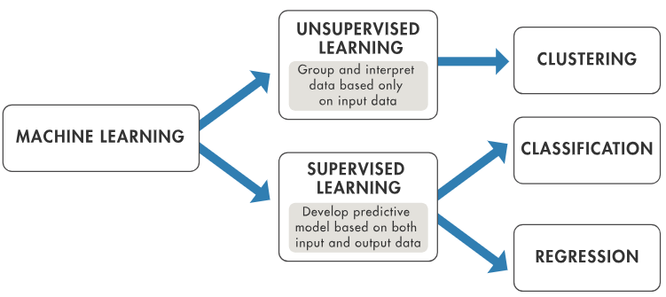
Supervised vs Unsupervised
Supervised: Could be more accurate but have learning bias, need training.
Unsupervised: Flexible, New Patterns

Slide 5
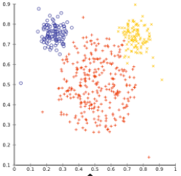
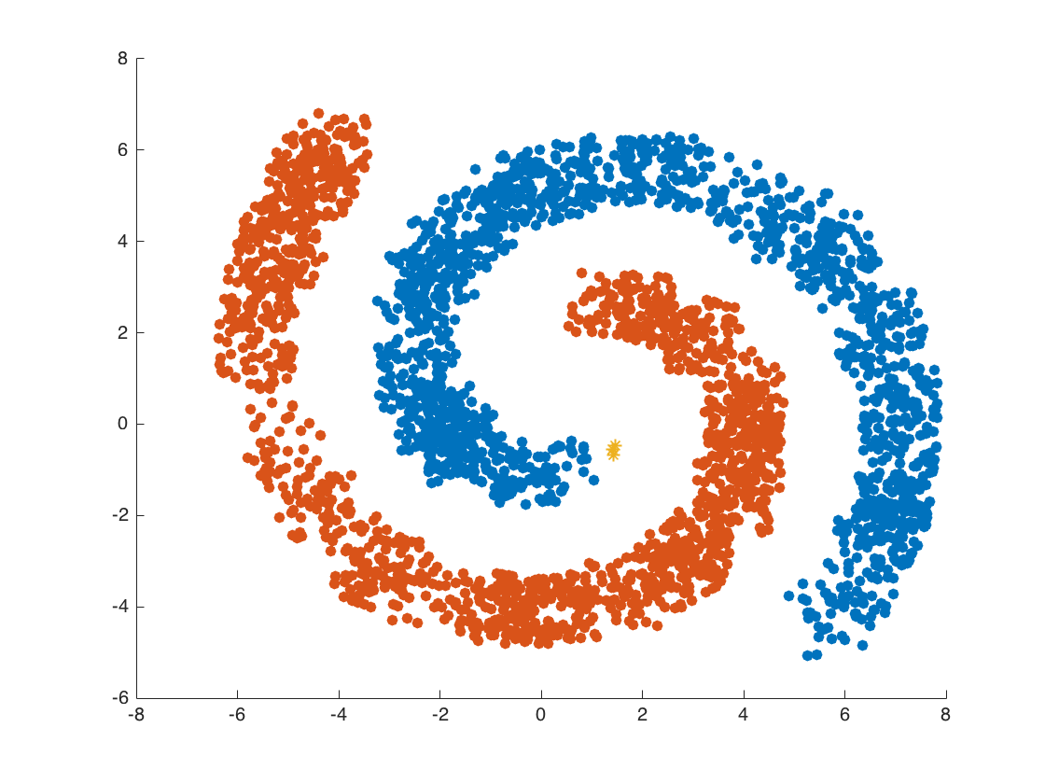
What’s Machine Learning?
“Learn” information from data
Pattern Recognition
Distance-based: K-means,…
Connectivity-based: DB-scan,…
Probability-based
…….
Notes:
Assume groups are independent, hard clustering

Slide 6
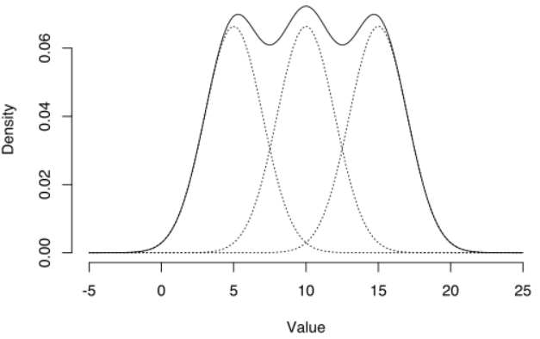
Mixture Model
Respect dependences between clusters

Slide 7
Agenda
Motivation
Asymmetric Gaussian Mixture Model
Learning Algorithm (RJMCMC)
Experimental Results (Spam Filtering)
Conclusion

Slide 8
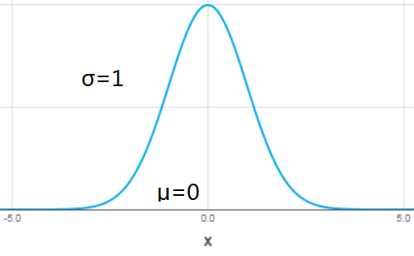
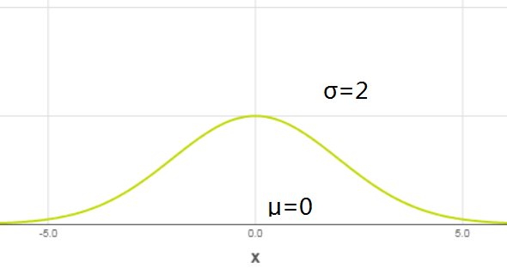
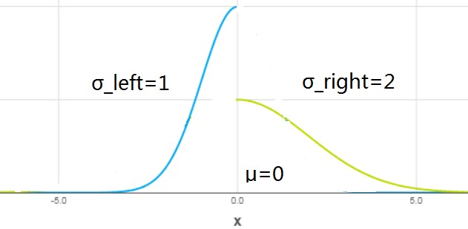
Asymmetric Gaussian
Joint of two Gaussian distributions for every dimension

Slide 9
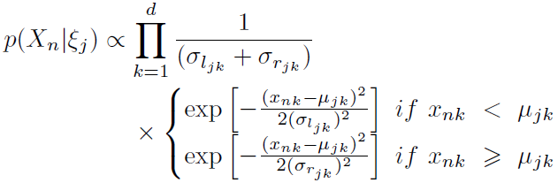
Asymmetric Gaussian Cont.
Probability density function (PDF)
Dimension-by-dimension

Slide 10


AGMM
M-dimensional membership vector Z
Weight parameter
Likelihood function of AGMM

Slide 11
Agenda
Motivation
Asymmetric Gaussian Mixture Model
Learning Algorithm (RJMCMC)
Experimental Results (Spam Filtering)
Conclusion

Slide 12
Markov Chain Monte Carlo
Sampling-based approximation
Non-deterministic
Flexible (proposal distributions, adjustable parameters)
Robust (error tolerance)

Slide 13
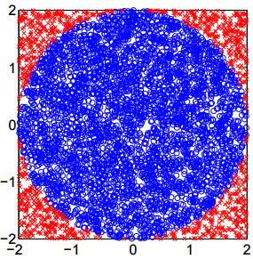
Monte Carlo Method
Example: Calculate PI using MC
Blue area: PI*R^2, the square area is 4*R^2, so the Blue/Total = PI/4
Generate samples (x,y) (-2<x<2, -2<y<2), if x^2 + y^2 < R^2, mark it as Blue, otherwise Red
Calculate the amount of Blue and Red
PI = 4*(Blue/(Blue + Red))
More samples, more accurate!

Slide 14
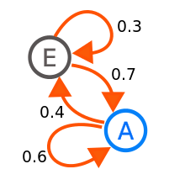
Markov Chain
Main goal: Given a proposal distribution describing status change, then forms a Markov chain.

Slide 15

MCMC Implementations
Metropolis-Hastings Algorithm
Sampling from proposal distribution
Sampling procedure is guided by an acceptance ratio to make a decision whether new status will be accepted or rejected

Slide 16
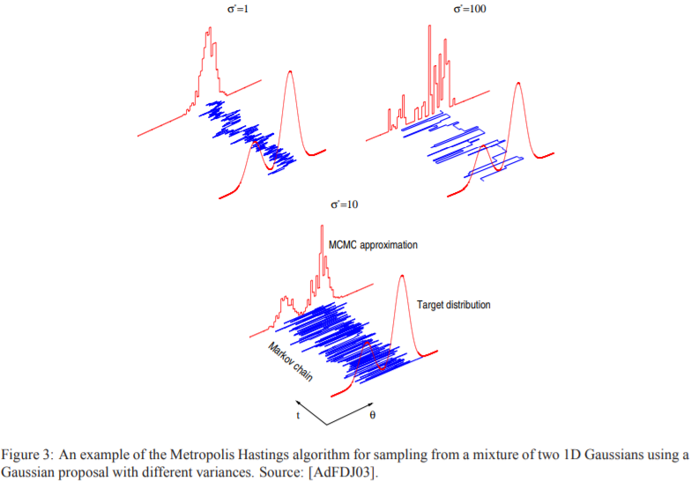
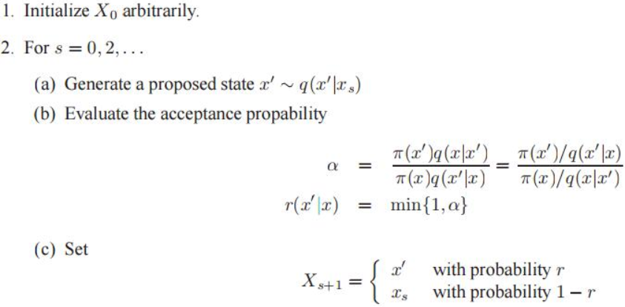
MCMC Implementations
Metropolis-Hastings Algorithm

Slide 17
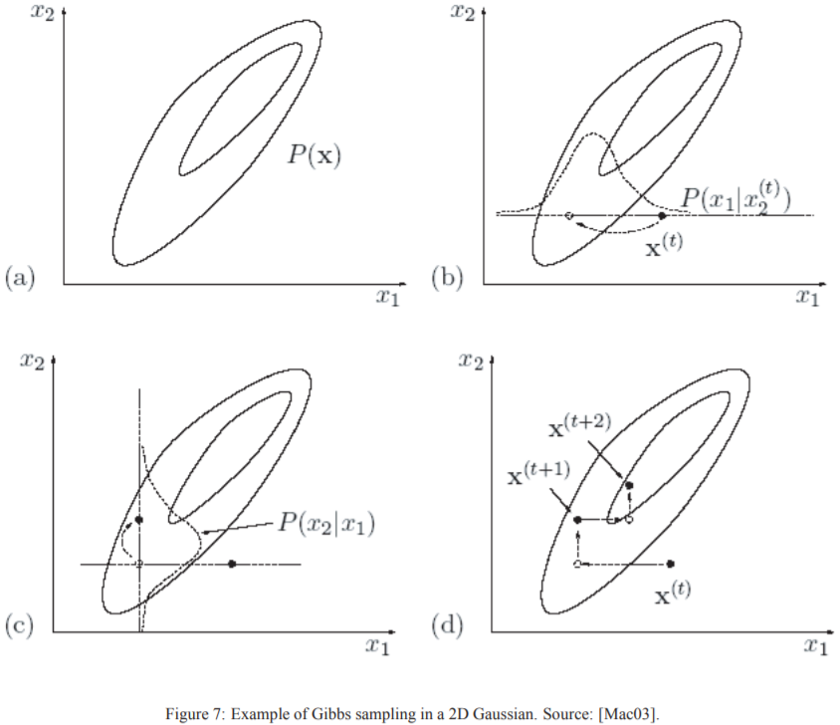

MCMC Implementations
Gibbs sampling
Proposal distribution is not needed
Acceptance probability is always 1

Slide 18
MH-within-Gibbs
Combining advantages of both implementations for different nature of parameters involved.

Slide 19
Reversible Jump JMCMC
Infinite and finite mixtures
Infinite: component number is between 1 to infinity.
Finite: component number is either
Fixed
Variable: RJMCMC

Slide 20
Reversible Jump MCMC
Assume the component number of the mixture model is unknown
Allow model transfer throughout iterations

Slide 21
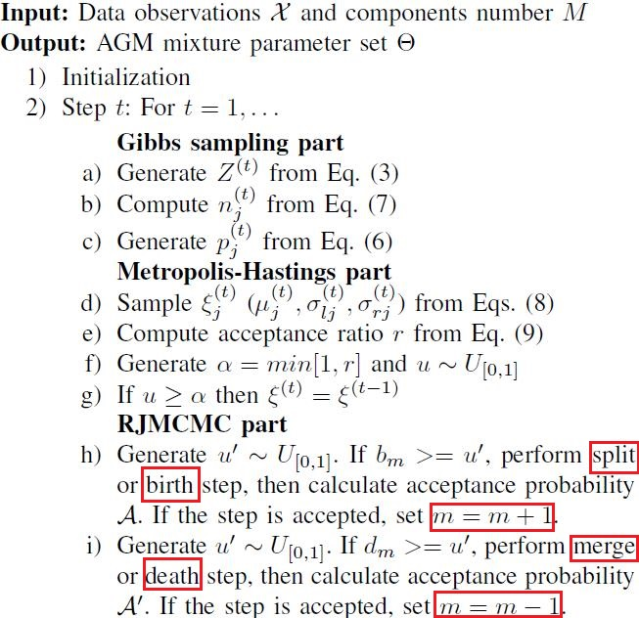
Reversible Jump MCMC
Steps involved in parameter learning

Slide 22
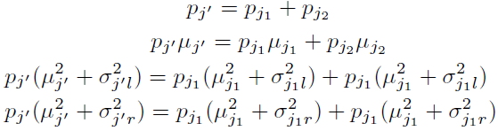
Reversible Jump MCMC
Split

Slide 23
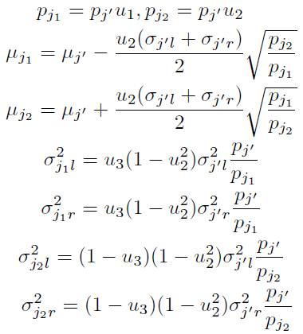
Reversible Jump MCMC
Merge

Slide 24
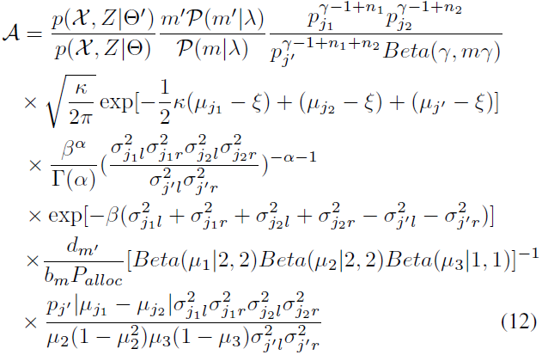
Reversible Jump MCMC
Acceptance probability for merge step is min(1;A) and for split step is min(1;A^-1)

Slide 25
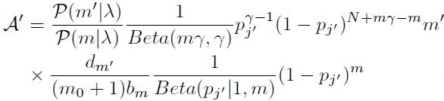
Reversible Jump MCMC
Birth and death
Newborn and dead components are empty ones which means parameter re-calculation is not needed
Re-scale mixture weight
Acceptance probability for birth and death are min(1;A) and min(1;A^-1)

Slide 26
Agenda
Motivation
Asymmetric Gaussian Mixture Model
Learning Algorithm (RJMCMC)
Experimental Results (Spam Filtering)
Conclusion

Slide 27
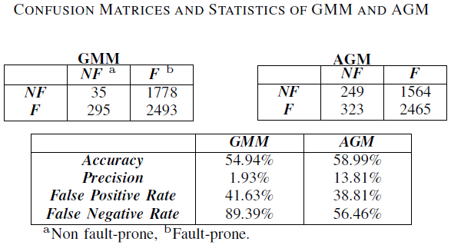
Spam Filtering
Dataset: Spambase
(Available: http://archive.ics.uci.edu/ml/datasets/Spambase?ref=datanews.io)

Slide 28
Agenda
Motivation
Asymmetric Gaussian Mixture Model
Learning Algorithm (RJMCMC)
Experimental Results (Spam Filtering)
Conclusion

Slide 29
Conclusion
A fully Bayesian analysis based on reversible jump MCMC of AGM model
Spam filtering using AGM model
Future work: Feature reduction, data-oriented model adjustment

Slide 30
Thank You!

Slide 31


